Slide 1
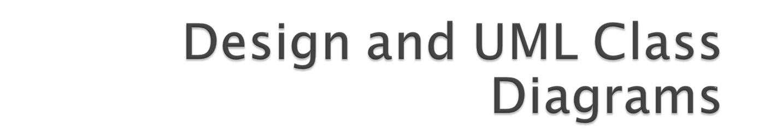

Slide 2
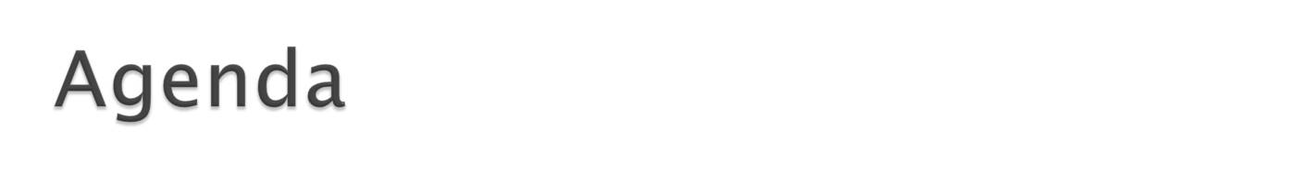
What is UML?
  Why should I bother? Do people really use UML?
What is a UML class diagram?
  What kind of information goes into it
  How to create it
  When should I create it

Slide 3
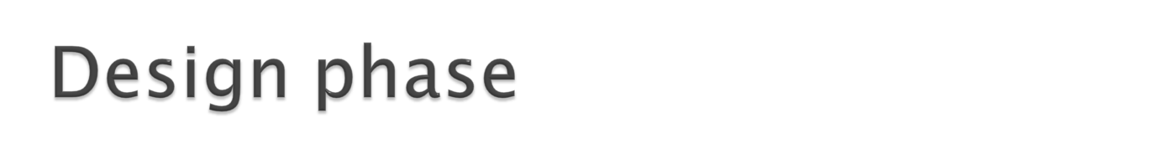
design: specifying the structure of how a software system will be written and function, without actually writing the complete implementation
a transition from "what" the system must do, to "how" the system will do it
  What classes will we need to implement a system that meets our requirements?
  What fields and methods will each class have?
  How will the classes interact with each other?

Slide 4
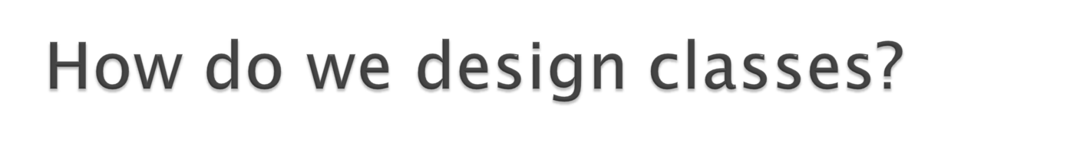
class identification from project spec / requirements
  nouns are potential classes, objects, fields
  verbs are potential methods or responsibilities of a class
UML diagrams
  class diagrams (today)
  sequence diagrams
  ...

Slide 5

UML: pictures of an OO system
  programming languages are not abstract enough for OO design
  UML is an open standard; lots of companies use it
What is legal UML?
  a descriptive language: rigid formal syntax (like programming)
  a prescriptive language: shaped by usage and convention
  it's okay to omit things from UML diagrams if they aren't needed by team/supervisor/instructor

Slide 6
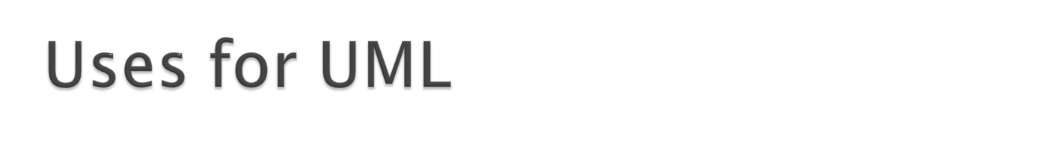
as a sketch: to communicate aspects of system
  forward design: doing UML before coding
  backward design: doing UML after coding as documentation
  often done on whiteboard or paper
  used to get rough selective ideas
as a blueprint: a complete design to be implemented
  sometimes done with CASE (Computer-Aided Software Engineering) tools
as a programming language: with the right tools, code can be auto-generated and executed from UML
  only good if this is faster than coding in a "real" language

Slide 7

What is a UML class diagram?
What are some things that are not represented in a UML class diagram?
  UML class diagram: a picture of the classes in an OO system, their fields and methods, and connections between the classes that interact or inherit from each other
  details of how the classes interact with each other
  algorithmic details; how a particular behavior is implemented

Slide 8
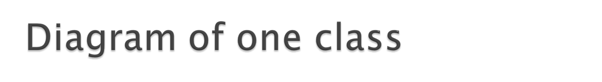
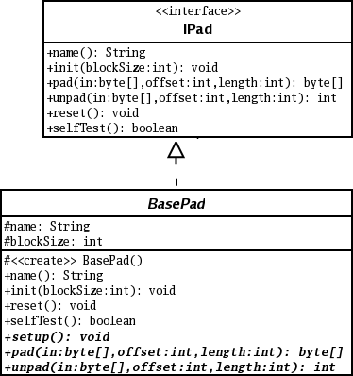
class name in top of box
  write <<interface>> on top of interfaces' names
  use italics for an abstract class name
attributes (optional)
  should include all fields of the object
operations / methods (optional)
  may omit trivial (get/set) methods
    but don't omit any methods from an interface!
  should not include inherited methods

Slide 9
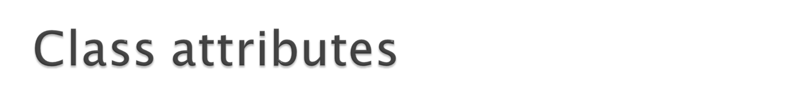
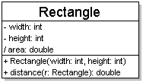
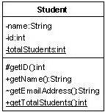
attributes (fields, instance variables)
  visibility name : type [count] = default_value
  visibility: + public
  # protected
  - private
  ~ package (default)
  / derived
  underline static attributes
  derived attribute: not stored, but can
  be computed from other attribute values
  attribute example:
  - balance : double = 0.00

Slide 10
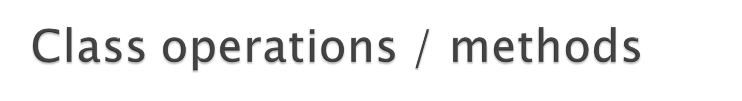
operations / methods
  visibility name (parameters) : return_type
  visibility: + public
  # protected
  - private
  ~ package (default)
  underline static methods
  parameter types listed as (name: type)
  omit return_type on constructors and
  when return type is void
  method example:
  + distance(p1: Point, p2: Point): double

Slide 11

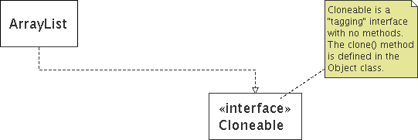
represented as a folded note, attached to the appropriate class/method/etc by a dashed line

Slide 12

generalization: an inheritance relationship
  inheritance between classes
  interface implementation
association: a usage relationship
  dependency
  aggregation
  composition

Slide 13
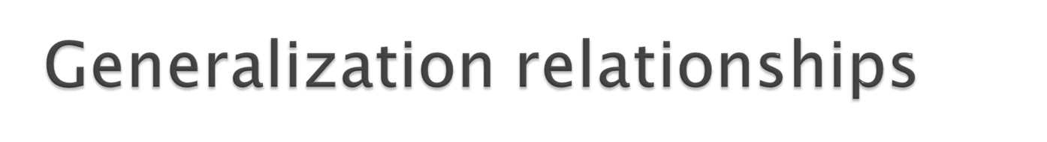
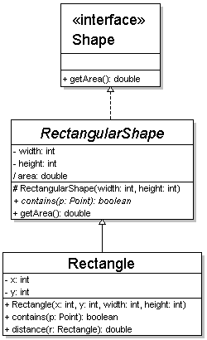
generalization (inheritance) relationships
  hierarchies drawn top-down with arrows pointing upward to parent
  line/arrow styles differ, based on whether parent is a(n):
    class:
    solid line, black arrow
    abstract class:
    solid line, white arrow
    interface:
    dashed line, white arrow
  we often don't draw trivial / obvious generalization relationships, such as drawing the Object class as a parent

Slide 14
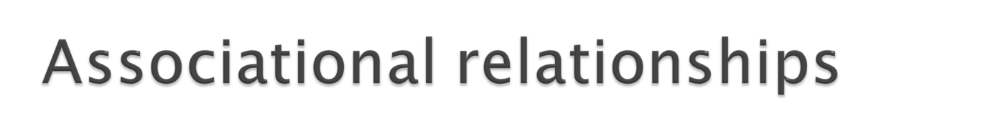
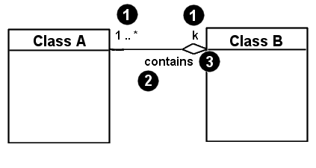
associational (usage) relationships
  1. multiplicity (how many are used)
    * ⇒ 0, 1, or more
    1 ⇒ 1 exactly
    2..4 ⇒ between 2 and 4, inclusive
    3..* ⇒ 3 or more
  2. name (what relationship the objects have)
  3. navigability (direction)

Slide 15

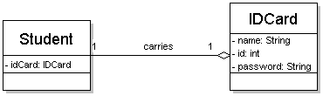
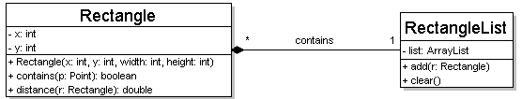
one-to-one
  each student must carry exactly one ID card
one-to-many
  one rectangle list can contain many rectangles

Slide 16
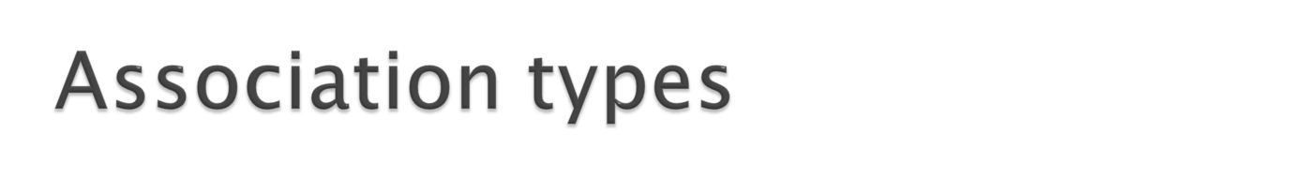
Car
1
aggregation: "is part of"
  symbolized by a clear white diamond
composition: "is entirely made of"
  stronger version of aggregation
  the parts live and die with the whole
  symbolized by a black diamond
dependency: "uses temporarily"
  symbolized by dotted line
  often is an implementation
  detail, not an intrinsic part of
  that object's state
1
aggregation
Engine
Book
composition
1
*
Page
dependency
Lottery
Ticket
Random

Slide 17
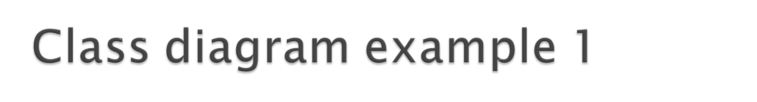
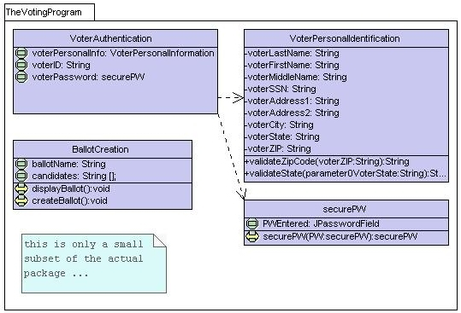

Slide 18
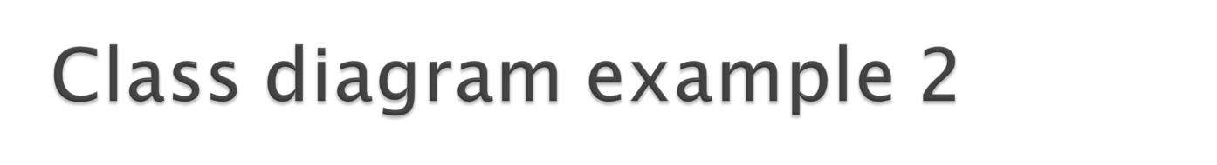
Multiplicity
Customer
1
Simple
Aggregation
Class
Abstract
Class
Rental Invoice
Rental Item
1..*
1
0..1
Composition
Simple
Association
Generalization
Checkout Screen
DVD Movie
VHS Movie
Video Game

Slide 19
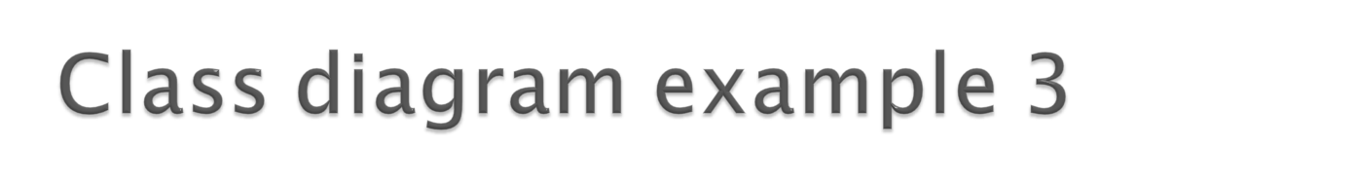

StudentBody
Student
1
100
- firstName : String
- lastName : String
- homeAddress : Address
- schoolAddress : Address
+ main (args : String[])
+ toString() : String
Address
- streetAddress : String
- city : String
- state : String
- zipCode : long
+ toString() : String

Slide 20

Violet (free)
  http://horstmann.com/violet/
Rational Rose
  http://www.rational.com/
Visual Paradigm UML Suite (trial)
  http://www.visual-paradigm.com/
  (nearly) direct download link:
  http://www.visual-paradigm.com/vp/download.jsp?product=vpuml&edition=ce

Slide 21
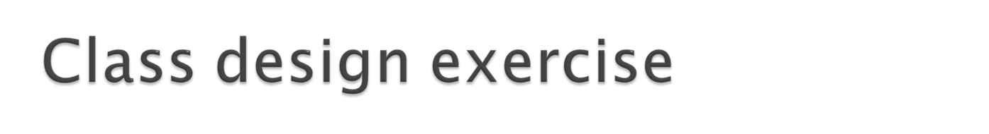
Consider this Texas Hold 'em poker game system:
  2 to 8 human or computer players
  Each player has a name and stack of chips
  Computer players have a difficulty setting: easy, medium, hard
  Summary of each hand:
    Dealer collects ante from appropriate players, shuffles the deck, and deals each player a hand of 2 cards from the deck.
    A betting round occurs, followed by dealing 3 shared cards from the deck.
    As shared cards are dealt, more betting rounds occur, where each player can fold, check, or raise.
    At the end of a round, if more than one player is remaining, players' hands are compared, and the best hand wins the pot of all chips bet so far.
  What classes are in this system? What are their responsibilities? Which classes collaborate?
  Draw a class diagram for this system. Include relationships between classes (generalization and associational).

Slide 22

http://courses.cs.washington.edu/courses/cse403/09sp/lectures/lecture07-uml.pdf
Further reading:
http://edn.embarcadero.com/article/31863

